Slide 1
NETWORK ANAMOLY DETECTION
A Case study in Machine Learning by Harish Julapalli(HJ00434741)

Slide 2
Overview
Business Context
Problem statement
Data set description
Exploratory Data Analysis
Model performance
Solution

Slide 3
Business Context
With the development of large open networks, security threats for the networks have increased significantly in the past few years. Different types of attacks possess different types of threats to network and network resources. Many different detection mechanisms have been proposed by various researchers. This is an attempt to predict such attacks in the network using various Machine Learning techniques available.

Slide 4
Problem statement
The task is to build network intrusion detection system to detect anomalies and attacks in the Network. There are two problems:
Binomial Classification: Predict whether an activity is normal or an anomaly.
Multinomial classification: Predict the type of attack - normal or DOS or PROBE or R2L or U2R.

Slide 5
Data set description
Training data has 125973 rows and 43 columns.
Test data has 22544 rows and 43 columns.
Most of our features are numerical. There are only 3 Categorical variables - 'protocol_type', 'service' and 'flag'. Our target features is: 'attack‘.
Data set does not have any missing values.

Slide 6
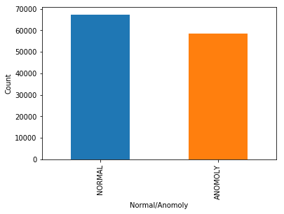
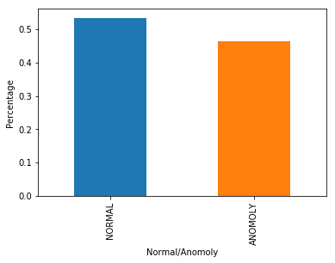
Exploratory Data Analysis
The data set is mostly divided equally between Anomalies and normal traffic from above visualization.

Slide 7
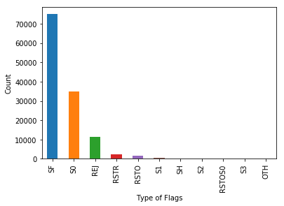
EDA – Distribution of Flags
‘SF’ and ‘S0’ Flags are present in more proportion in the data set.

Slide 8
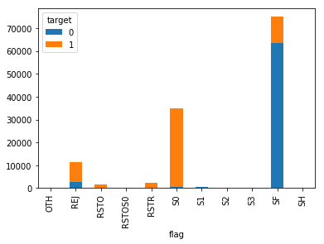
EDA – Distribution of Attacks over various flags
Most of the Attacks are shown by ‘S0’ flag and most of the normal traffic is shown in ‘SF’

Slide 9
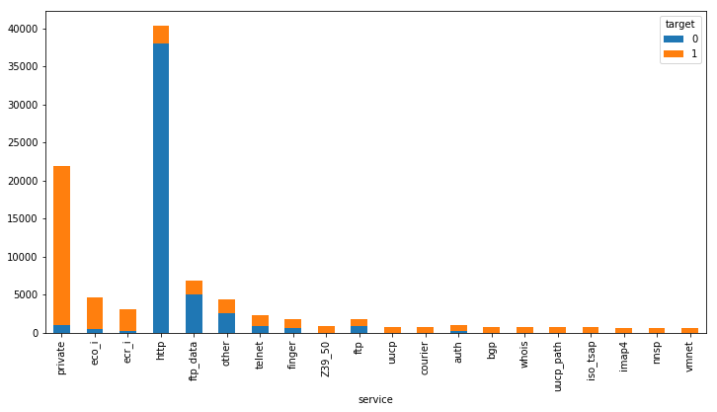
EDA – Distribution of attacks over various Destination services
Most of the attacks are occurring on ‘private’ services. The destination service ‘http’ has most of the normal traffic.

Slide 10
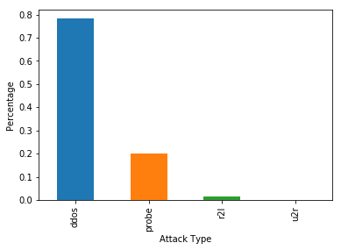
EDA – Distribution of various attacks
DDOS attack is the most occurring attack. The Dataset is imbalanced one with very few ‘r2l’ and ‘u2r’ classes.

Slide 11
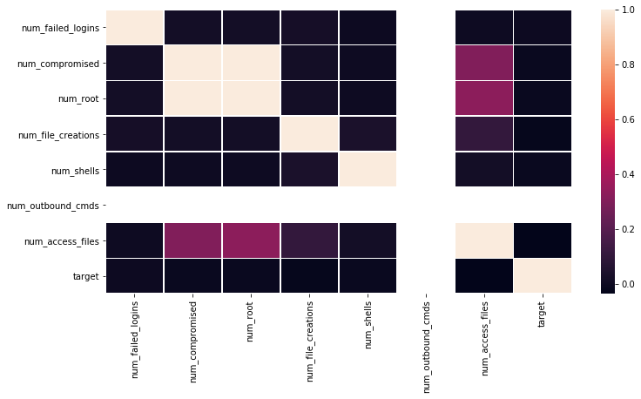
EDA – Correlation between various content related features
From above plot it is evident that the feature, 'num_outbound_cmds' is highly correlated with all other content related features.
The features, 'num_compromised' and 'num_root' are also higly correlated

Slide 12
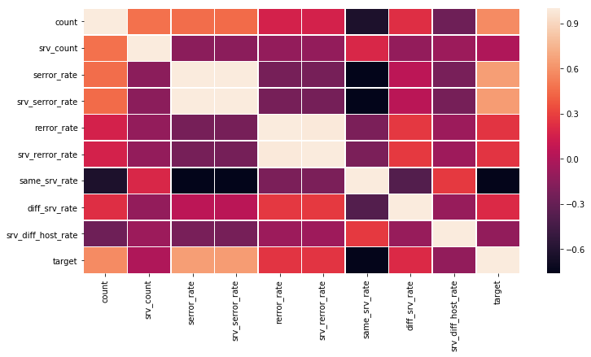
EDA – Correlation between various time related features
From the heatmap above, 'srv_serror_rate' and 'serror_rate' are highly correlated. Also, 'rerror_rate' and 'srv_rerror_rate' are highly correlated.

Slide 13
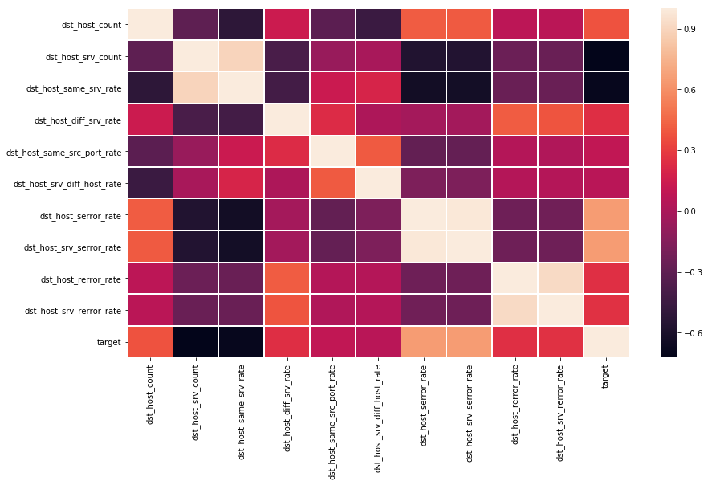
EDA – Correlation between various host related features
Our target feature is highly correlated with features like, 'dst_host_serror_rate' and 'dst_host_srv_serror_rate'.

Slide 14
Validation set selection:
I have set out a validation set separately for assessing the model performance and tuning model parameters. Around 20% of the data is set as hold out set.
20% of the total rows in the training set will be: 25194 examples, which will be a good hold-out set for evaluating the model.

Slide 15
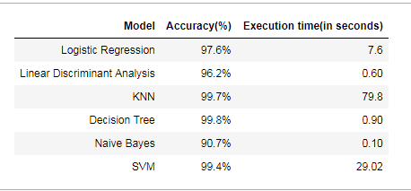
Model Building – Binary classification
Based on above table, considering Accuracy and training time, it is best to select Decision tree classifier.

Slide 16
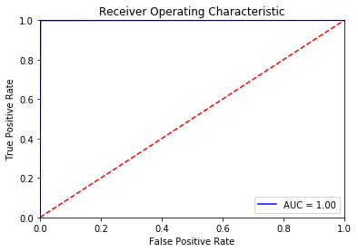
Evaluation metrics of Decision Tree classifier
Accuracy = 99.8%
AUC = 0.998

Slide 17
Evaluation metrics of Decision Tree classifier
Confusion Matrix:
True Positive Rate: 0.999058299803099
False Positive Rate: 0.001627941394109812
F1-Score: 0.9985881144910794
Predicted | Normal | Attack
Actual
Normal | 13492 | 22
Attack | 11 | 11679

Slide 18
Predicting the type of Attack - Models
Models used for predicting the type of attack: Gaussian Naïve Bayes, K Nearest Neighbours, Random Forest.
Model | Accuracy
Naive Bayes | 63%
KNN | 99.7%
Random Forest | 99.7%
Based on Accuracy score and time taken to learn the model, Random Forest classifier is chosen.

Slide 19
Predicting type of Attack – Random Forest Classifier
n_estimators = 12
Criterion = ‘gini’
Max_features = None

Slide 20
Random Forest – Metrics on validation set
Accuracy = 99.3%
Confusion matrix:
Predicted | Ddos | Normal | Probe | R2l | U2r
Actual
ddos | 9218 | 0 | 1 | 0 | 0
Normal | 2 | 13506 | 2 | 2 | 2
probe | 0 | 3 | 2246 | 0 | 0
R2l | 0 | 4 | 0 | 200 | 1
U2r | 0 | 0 | 0 | 0 | 8
Our model was able to predict well even the minority classes: ‘r2l’ and ‘u2r’

Slide 21
Random Forest – Metrics on validation set
Class | Accuracy | TPR | FPR | F1-Score
ddos | 99% | 0.999892 | 0.000125188 | 0.999837
Normal | 99% | 0.999408 | 0.000599264 | 0.999445
probe | 99% | 0.998666 | 0.000130742 | 0.998666
R2l | 99% | 0.97561 | 8.0032e-05 | 0.982801
U2r | 99% | 1 | 0.000119109 | 0.842105

Slide 22
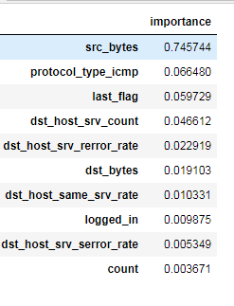
Best features used to predict an attack with importance score:
Based on the best features selected by the Decision tree, source bytes, protocol ICMP, dst_host_srv_count are very important to tag an attack as Anomoly.
Conclusion: Any variations in above features can be susceptible to Attack and can be looked upon further.

Slide 23
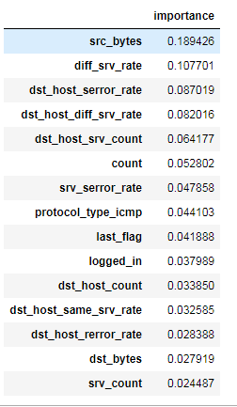
Best features used to predict the type of attack with importance score:
Based on the best features selected by the Decision tree, source bytes, diff_srv_rate, dst_host_serror_rate are very important to predict.
Conclusion: Any variations in above features can be susceptible to Attack and can be looked upon further.

Slide 24
References
Feature Selection and Intrusion classification in NSL-KDD Cup 99 Dataset Employing SVMs Muhammad Shakil Pervez, and Dewan Md. Farid
A Two Stage Intrusion Detection Intelligent System Nevrus Kaja, Adnan Shaout and Di Ma
Data Science & Machine Learning in Cybersecurity
Different types of Network Attacks
Introduction to machine learning with python - Andreas Mueller

